Slide 1
SQL Query Optimization:
Why Is It So Hard To Get Right?
David J. DeWitt
Microsoft Jim Gray Systems Lab
Madison, Wisconsin
dewitt@microsoft.com
© 2010 Microsoft Corporation. All rights reserved. This presentation is for informational purposes only.
Microsoft makes no warranties, express or implied in this presentation.

Slide 2



Who Is This Guy Again?
DeWitt
M
Spent 32 years as a computer science professor
at the University of Wisconsin
Joined Microsoft in March 2008
Runs the Jim Gray Systems Lab in Madison, WI
Lab is closely affiliated with the DB group at University of Wisconsin
3 faculty and 8 graduate students working on projects
Built analytics and semijoin components of PDW V1. Currently working on a number of features for PDW V2

Slide 3
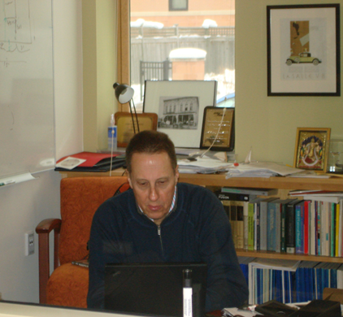

A Third Keynote?
I am running out of things
to talk about
Generating all this PowerPoint takes me days and days (unlike my boss, I do not have people to do my slide decks)
My wife decided to show up & see what all the fuss was about!
(She is probably the only one not tweeting back there)
Still no motorcycle to ride across the stage

Slide 4





A Third Keynote?
How can I
Got to show off
the PDW Appliance
Got to tell you about SQL 11
Possibly
1
IMPRESS YOU?
2
My boss’s boss
My boss
The “Impress Index”
Me
You Are Here
3
Cool!
Awesome!
Day 1
Day 2
Day 3
(Ted Kummert)
(Quentin Clark)
(David DeWitt)

Slide 5

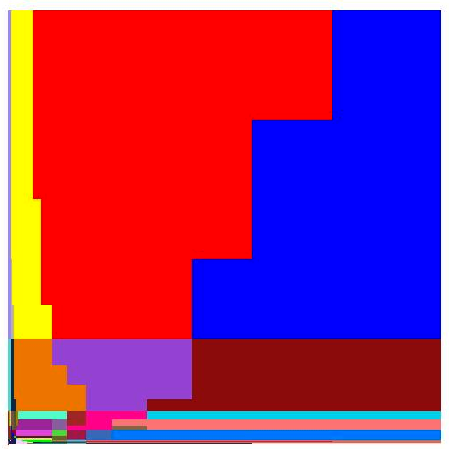
How About a Quiz to Start!
Who painted this picture?
Mondrian?
Picasso?
Ingres?
Actually it was the SQL Server query optimizer!!
Plan space for TPC-H query 8 as the parameter values for Acct-Bal and ExtendedPrice are varied
Each color represents a different query plan
Yikes!
P₁
P₂
P₃
P₄
SQL
Server

Slide 6

Today …
I am going to talk about SQL query optimization (another power lecture)
You voted for this topic on the PASS web site
Don’t blame me if you didn’t vote and wanted to hear about map-reduce and no-sql database systems instead
Starting with the fundamental principals
Map-Reduce
Query Optimization
My hope is that you will leave understanding why all database systems sometimes produce really bad plans

Slide 7

Anonymous Quote
“Query optimization is not rocket science. When you flunk out of query optimization, we make you go build rockets.”

Slide 8
The Role of the Query Optimizer (100,000 ft view)
Magic Happens
SQL
Statement
Awesome
Query Plan
Query Optimizer

Slide 9
What’s the Magic?
Consider Query 8 of the TPC-H benchmark:
A very big haystack to be searching through
Select o_year, sum(case
when nation = 'BRAZIL' then volume
else 0
end) / sum(volume)
from
(
select YEAR(O_ORDERDATE) as o_year, L_EXTENDEDPRICE * (1 - L_DISCOUNT) as volume, n2.N_NAME as nation
from PART, SUPPLIER, LINEITEM, ORDERS, CUSTOMER, NATION n1, NATION n2, REGION
where
P_PARTKEY = L_PARTKEY and S_SUPPKEY = L_SUPPKEY
and L_ORDERKEY = O_ORDERKEY and O_CUSTKEY = C_CUSTKEY
and C_NATIONKEY = n1.N_NATIONKEY and n1.N_REGIONKEY = R_REGIONKEY and R_NAME = 'AMERICA‘ and S_NATIONKEY = n2.N_NATIONKEY and O_ORDERDATE between '1995-01-01' and '1996-12-31'
and P_TYPE = 'ECONOMY ANODIZED STEEL'
and S_ACCTBAL <= constant-1
and L_EXTENDEDPRICE <= constant-2
) as all_nations
group by o_year order by o_year
Should not take hours or days to pick a plan!
…
There about 22 million alternative ways of executing this query!
22 million plans
The QO must select a plan that runs in seconds or minutes, not days or weeks!
Plan 1
Plan 2
Plan 3
Plan 4
Plan 5

Slide 10
Some Historical Background
Cost-based query optimization was invented by Pat Selinger as part of the IBM System R project in the late 1970s (System R became DB2)
Remains the hardest part of building a DBMS 30+ years later
Progress is hindered by fear of regressions
Far too frequently the QO picks an inefficient plan
Situation further complicated by advances in hardware and the rest of the DBMS software
Hardware is 1000X bigger and faster
DB software is 10X faster
Queries over huge amounts of data are possible IF the QO picks the right plan
System R
Hardware
Software
Queries
Huge!
10X
1000X

Slide 11
More Precisely: The Role of the Query Optimizer
Transform SQL queries into an efficient execution plan
Database System
Query Execution Engine
Query Optimizer
SQL Query
Parser
Logical operator tree
Physical operator tree
Logical operators: what they do
e.g., union, selection, project, join, grouping
Physical operators: how they do it
e.g., nested loop join, sort-merge join, hash join, index join

Slide 12
A First Example
Reviews
Date | CID | MID | Rating
… | … | … | …
SELECT Average(Rating)
FROM Reviews WHERE MID = 932
Query Optimizer
Query Execution Engine
Parser
Avg (Rating)
or
Avg_agg [Cnt, Sum]
Avg_agg [Cnt, Sum]
Select MID = 932
Index Lookup MID = 932
Filter MID = 932
Reviews
Scan
MID Index
Logical operator tree
Reviews
Reviews
Query Plan #1
Query Plan #2

Slide 13
Query Plan #1
Plan starts by scanning the entire Reviews table
# of disk I/Os will be equal to the # of pages in the Reviews table
I/Os will be sequential. Each I/O will require about 0.1 milliseconds (0.0001 seconds)
Filter predicate “MID = 932” is applied to all rows
Only rows that satisfy the predicate are passed on to the average computation
Avg_agg [Cnt, Sum]
Filter MID = 932
Scan
Reviews

Slide 14
Query Plan #2
Avg_agg [Cnt, Sum]
MID index is used to retrieve only those rows whose MID field (attribute) is equal to 932
Since index is not “clustered”, about one disk I/O will be performed for each row
Each disk I/O will require a random seek and will take about 3 milliseconds (ms)
Retrieved rows will be passed to the average computation
Index Lookup MID = 932
MID Index
Reviews

Slide 15

Which Plan Will be Faster?
Vs.
Avg_agg [Cnt, Sum]
Query optimizer must pick between the two plans by estimating the cost of each
To estimate the cost of a plan, the QO must:
Estimate the selectivity of the predicate MID=932
Calculate the cost of both plans in terms of CPU time and I/O time
The QO uses statistics about each table to make these estimates
The “best” plan depends on how many reviews there are for movie with MID = 932
Avg_agg [Cnt, Sum]
Index Lookup MID = 932
Filter MID = 932
Scan
MID Index
Reviews
Reviews
Query Plan #1
?
Query Plan #2
?
or
?
Best Query Plan
How many reviews for the movie with MID = 932 will there be?

Slide 16



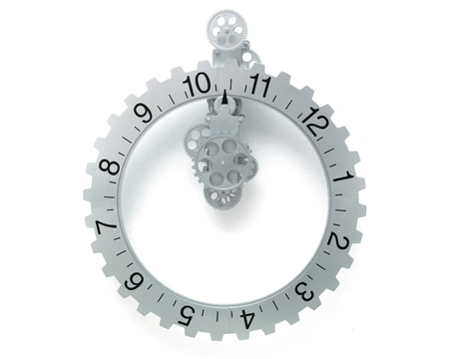
Query Optimization: The Main Steps
Enumerate logically equivalent plans by applying equivalence rules
✓
1
For each logically equivalent plan, enumerate all alternative physical query plans
2
Estimate the cost of each of the alternative physical query plans
3
Run the plan with lowest estimated overall cost
4
Notes:
Rounded corner rectangle tabs with inset pictures
(Advanced)
To reproduce the top rectangle (olive-green, “label one”) with text effects on this slide, do the following:
On the Home tab, in the Slides group, click Layout, and then click Blank.
On the Home tab, in the Drawing group, click Shapes, and then under Rectangles, click Rounded Diagonal Corner Rectangle (ninth option from the left). On the slide, drag to draw a rectangle.
On the Home tab, in the bottom right corner of the Drawing group, click the Format Shape dialog box launcher. In the Format Shape dialog box, click Fill in the left pane, select Gradient fill in the right pane, and then do the following:
In the Type list, select Linear.
Click the button next to Direction, and then click Linear Down (first row, second option from the left).
Under Gradient stops, click Add or Remove until two stops appear in the drop-down list.
Also under Gradient stops, customize the gradient stops that you added as follows:
Select Stop 1 from the list, and then do the following:
In the Stop position box, enter 32%.
Click the button next to Color, and then under Theme Colors click White, Background 1 (first row, first option from the left).
Select Stop 2 from the list, and then do the following:
In the Stop position box, enter 100%.
Click the button next to Color, and then under Theme Colors click Olive Green, Accent 3, Lighter 60% (third row, seventh option from the left).
Also in the Format Shape dialog box, click Line Color in the left pane, select Gradient line in the right pane, and then do the following:
In the Type list, select Linear.
Click the button next to Direction, and then click Linear Up (second row, second option from the left).
Under Gradient stops, click Add or Remove until two stops appear in the drop-down list.
Also under Gradient stops, customize the gradient stops that you added as follows:
Select Stop 1 from the list, and then do the following:
In the Stop position box, enter 0%.
Click the button next to Color, and then under Theme Colors click White, Background 1 (first row, first option from the left).
Select Stop 2 from the list, and then do the following:
In the Stop position box, enter 100%.
Click the button next to Color, and then under Theme Colors click White, Background 1, Darker 25% (fourth row, first option from the left).
Also in the Format Shape dialog box, click Line Style in the left pane. In the Line Style pane, in the Width box, enter 1 pt.
On the Home tab, in the Drawing group, click Shape Effects, point to Glow, and then do the following:
Under Glow Variations, select any option in the first row (5 pt glow options).
Point to More Glow Colors, and then under Theme Colors click White, Background 1, Darker 25% (fourth row, first option from the left).
On the slide, right-click the rectangle and then click Edit Text.
Enter text in the text box and select the text. On the Home tab, in the Font group, select Gill Sans MT from the Font list and then select 24 from the Font Size list.
On the Home tab, in the Paragraph group, click Align Text Left to align the text left within the rectangle.
Under Drawing Tools, on the Format tab, in the WordArt Styles group, click the arrow next to Text Fill, click More Fill Colors, and then in the Colors dialog box, on the Custom tab, enter values for Red: 127, Green: 127, and Blue: 127.
Select the rectangle. On the Home tab, in the bottom-right corner of the Drawing group, click the Format Shapes dialog box launcher. In the Format Shapes dialog box, click Text Box in the left pane. In the right pane, under Internal margin, enter 1” in the Left box to increase the left margin in the rectangle to accommodate the embossed picture.
Under Drawing Tools, on the Format tab, in the Size group, do the following:
In the Shape Height box, enter 0.92”.
In the Shape Width box, enter 4.5”.
To reproduce the olive-green embossed picture for the top rectangle on this slide, do the following:
On the Home tab, in the Drawing group, click Shapes, and then under Rectangles, click Rounded Diagonal Corner Rectangle (ninth option from the left). On the slide, drag to draw a rectangle.
On the Home tab, in the bottom right corner of the Drawing group, click the Format Shape dialog box launcher. In the Format Shape dialog box, click Fill in the left pane, select Picture or texture fill, and then under Insert from click File.
In the Insert Picture dialog box, select a picture and then click Insert.
Also in the Format Shape dialog box, click Line Color in the left pane. In the Line Color pane, select No line.
Also in the Format Shape dialog box, click Picture in the left pane, click the button next to Recolor, and then under Light Variations click Accent color 3 Light (fourth option from the left).
Also in the Format Shape dialog box, click Shadow in the left pane, and then do the following in the right pane:
Click the button next to Preset, and then under Inner click Inside Diagonal Top Left (first row, first option from the left).
In the Transparency box, enter 65%.
Under Picture Tools, on the Format tab, in the bottom right corner of the Size group, click the Size and Position dialog box launcher. In the Size and Position dialog box, on the Size tab, do the following:
Under Scale, select the Lock aspect ratio check box.
Under Size and rotate, in the Height box, enter 0.75”. (Under Size and rotate, in the Width box, 0.75” will appear automatically.)
Drag the picture onto the left side of the rectangle.
Press and hold CTRL and select the picture and the rectangle. On the Home tab, in the Drawing group, click Arrange, point to Align, and then click Align Middle.
To reproduce the other shapes on this slide, do the following:
Press and hold CTRL and select the picture and the rectangle. On the Home tab, in the Drawing group, click Arrange, and then click Group.
On the Home tab, in the Clipboard group, click the arrow under Paste, and then click Duplicate. Repeat the process until there is a total of four groups of shapes.
Drag the groups so that they are distributed vertically on the slide. Press and hold CTRL and select all four groups. On the Home tab, in the Drawing group, click Arrange, and then do the following:
Point to Align, and then click Align Center.
Point to Align, and then click Distribute Vertically.
Click Ungroup.
To change the color and text for the duplicate rectangles (second, third, and fourth from the top), do the following:
Select the rectangle that you would like to recolor.
Under Drawing Tools, on the Format tab, in the Shape Styles group, click the arrow next to Shape Fill, point to Gradient, and then click More Gradients.
In the Format Shape dialog box, click Fill in the left pane, select Gradient fill in the right pane, and then do the following:
For the second rectangle from the top, under Gradient stops, select Stop 2 from the drop-down list, click the button next to Color, and then under Theme Colors click Orange, Accent 6, Lighter 60% (third row, tenth option from the left).
For the third rectangle from the top, under Gradient stops, select Stop 2 from the drop-down list, click the button next to Color, and then under Theme Colors click Aqua, Accent 5, Lighter 60% (third row, ninth option from the left).
For the fourth rectangle from the top, under Gradient stops, select Stop 2 from the drop-down list, click the button next to Color, and then under Theme Colors click Blue, Accent 1, Lighter 60% (third row, fifth option from the left).
To change the text on the duplicate rectangles, click in each text box and edit the text.
To change the picture on the duplicate rectangles (second, third, and fourth from the top), do the following:
Right-click the second picture from the top, and then click Format Picture.
In the Format Picture dialog box, click Fill in the left pane, and then under Insert from click File.
In the Insert Picture dialog box, select a picture, and then click Insert.
Repeat the process for the third and fourth rectangles from the top.
To change the color for the duplicate pictures (second, third, and fourth from the top), do the following:
Select the picture that you would like to recolor.
Under Picture Tools, on the Format tab, in the Adjust group, click the arrow next to Recolor, and then do the following:
For the second picture from the top, under Light Variations, click Accent color 6 Light (seventh option from the left).
For the third picture from the top, under Light Variations, click Accent color 5 Light (sixth option from the left).
For the fourth picture from the top, under Light Variations, click Accent color 1 Light (second option from the left).
To reproduce the background on this slide, do the following:
Right-click the slide background area, and then click Format Background. In the Format Background dialog box, click Fill in the left pane, select Gradient fill in the right pane, and then do the following:
In the Type list, select Radial.
Click the button next to Direction, and then click From Center (third option from the left).
Under Gradient stops, click Add or Remove until two stops appear in the drop-down list.
Also under Gradient stops, customize the gradient stops that you added as follows:
Select Stop 1 from the list, and then do the following:
In the Stop position box, enter 0%.
Click the button next to Color, and then under Theme Colors click White, Background 1 (first row, first option from the left).
Select Stop 2 from the list, and then do the following:
In the Stop position box, enter 100%.
Click the button next to Color, and then under Theme Colors click White, Background 1, Darker 15% (third row, first option from the left).

Slide 17
Equivalence Rules
Select and join operators commute with each other
Select
Select
Select
Select
Join
Join
Reviews
Customers
Customers
Reviews
Customers
Customers
Join operators are associative
Join
Join
Join
Movies
Customers
Join
Customers
Reviews
Reviews
Movies

Slide 18
Equivalence Rules (cont.)
Select operator distributes over joins
Select
Join
Join
Select
Reviews
Customers
Reviews
Customers
Project [Name]
Project operators
cascade
Project [Name]
Project [CID, Name]
Customers
Customers

Slide 19
Example of Equivalent Logical Plans
SELECT M.Title, M.Director
FROM Movies M, Reviews R, Customers C WHERE C.City = “N.Y.” AND R.Rating > 7
AND M.MID = R.MID AND C.CID = R.CID
One possible logical plan:
Find titles and director names of movies that received a rating > 7 from customers residing in NYC
Project
M.Title, M.Director
Join
R.MID = M.MID
Join
Movies
C.CID = R.CID
Movies
MID | Title | Director | Earnings
1
2
…
C.City = “N.Y”
Select
Select
R.Rating > 7
Customers
Customers
Reviews
Reviews
CID | Name | Address | City
5
11
…
Date | CID | MID | Rating
7/3 | 11 | 2 | 8
7/3 | 5 | 2 | 4
…

Slide 20
Five Logically “Equivalent” Plans
The “original” plan
Project
Project
Selects distribute over joins rule
Join
Join
Select
Movies
Join
Movies
Select
Select
Join
Selects distribute over joins rule
Selects distribute over joins rule
Select
Customers
Reviews
Project
Customers
Reviews
Join
Project
Project
Join
Select
Movies
Join
Select
Join
Movies
Select
Select
Select
Movies
Select
Join
Customers
Reviews
Join
Customers
Reviews
Customers
Reviews
Selects commute rule

Slide 21
Four More!
Project
Join
The “original” plan
Join
Movies
Project
Select
Select
Select
Customers
Reviews
Join
Join commutativity rule
Selects distribute over joins rule
Join
Select
Movies
Customers
Project
Reviews
Join
Join
Select
Selects distribute over joins rule
Project
Select
Movies
Customers
Project
Select
Join
Join
Reviews
Select
Select
Select
Selects distribute over joins rule
Join
Customers
Join
Customers
Reviews
Movies
Reviews
Movies

Slide 22
9 Logically Equivalent Plans, In Total
Project
Project
Project
Join
Join
Join
Project
Join
Select
Join
Movies
Movies
Select
Movies
Select
Select
Select
Join
Movies
Join
Select
Select
Join
Customers
Reviews
Select
All 9 logical plans will produce the same result
For each of these 9 plans there is a large number of alternative physical plans that the optimizer can choose from
Customers
Reviews
Customers
Reviews
Customers
Reviews
Project
Project
Join
Join
Join
Select
Select
Movies
Select
Project
Select
Movies
Customers
Project
Join
Select
Project
Select
Reviews
Join
Join
Join
Customers
Reviews
Join
Select
Select
Select
Join
Customers
Select
Movies
Customers
Join
Customers
Reviews
Movies
Reviews
Reviews
Movies

Slide 23
Query Optimization: The Main Steps
Enumerate logically equivalent plans by applying equivalence rules
✓
1
For each logically equivalent plan, enumerate all alternative physical query plans
✓
2
Estimate the cost of each of the alternative physical query plans
3
Run the plan with lowest estimated overall cost
4
Notes:
Rounded corner rectangle tabs with inset pictures
(Advanced)
To reproduce the top rectangle (olive-green, “label one”) with text effects on this slide, do the following:
On the Home tab, in the Slides group, click Layout, and then click Blank.
On the Home tab, in the Drawing group, click Shapes, and then under Rectangles, click Rounded Diagonal Corner Rectangle (ninth option from the left). On the slide, drag to draw a rectangle.
On the Home tab, in the bottom right corner of the Drawing group, click the Format Shape dialog box launcher. In the Format Shape dialog box, click Fill in the left pane, select Gradient fill in the right pane, and then do the following:
In the Type list, select Linear.
Click the button next to Direction, and then click Linear Down (first row, second option from the left).
Under Gradient stops, click Add or Remove until two stops appear in the drop-down list.
Also under Gradient stops, customize the gradient stops that you added as follows:
Select Stop 1 from the list, and then do the following:
In the Stop position box, enter 32%.
Click the button next to Color, and then under Theme Colors click White, Background 1 (first row, first option from the left).
Select Stop 2 from the list, and then do the following:
In the Stop position box, enter 100%.
Click the button next to Color, and then under Theme Colors click Olive Green, Accent 3, Lighter 60% (third row, seventh option from the left).
Also in the Format Shape dialog box, click Line Color in the left pane, select Gradient line in the right pane, and then do the following:
In the Type list, select Linear.
Click the button next to Direction, and then click Linear Up (second row, second option from the left).
Under Gradient stops, click Add or Remove until two stops appear in the drop-down list.
Also under Gradient stops, customize the gradient stops that you added as follows:
Select Stop 1 from the list, and then do the following:
In the Stop position box, enter 0%.
Click the button next to Color, and then under Theme Colors click White, Background 1 (first row, first option from the left).
Select Stop 2 from the list, and then do the following:
In the Stop position box, enter 100%.
Click the button next to Color, and then under Theme Colors click White, Background 1, Darker 25% (fourth row, first option from the left).
Also in the Format Shape dialog box, click Line Style in the left pane. In the Line Style pane, in the Width box, enter 1 pt.
On the Home tab, in the Drawing group, click Shape Effects, point to Glow, and then do the following:
Under Glow Variations, select any option in the first row (5 pt glow options).
Point to More Glow Colors, and then under Theme Colors click White, Background 1, Darker 25% (fourth row, first option from the left).
On the slide, right-click the rectangle and then click Edit Text.
Enter text in the text box and select the text. On the Home tab, in the Font group, select Gill Sans MT from the Font list and then select 24 from the Font Size list.
On the Home tab, in the Paragraph group, click Align Text Left to align the text left within the rectangle.
Under Drawing Tools, on the Format tab, in the WordArt Styles group, click the arrow next to Text Fill, click More Fill Colors, and then in the Colors dialog box, on the Custom tab, enter values for Red: 127, Green: 127, and Blue: 127.
Select the rectangle. On the Home tab, in the bottom-right corner of the Drawing group, click the Format Shapes dialog box launcher. In the Format Shapes dialog box, click Text Box in the left pane. In the right pane, under Internal margin, enter 1” in the Left box to increase the left margin in the rectangle to accommodate the embossed picture.
Under Drawing Tools, on the Format tab, in the Size group, do the following:
In the Shape Height box, enter 0.92”.
In the Shape Width box, enter 4.5”.
To reproduce the olive-green embossed picture for the top rectangle on this slide, do the following:
On the Home tab, in the Drawing group, click Shapes, and then under Rectangles, click Rounded Diagonal Corner Rectangle (ninth option from the left). On the slide, drag to draw a rectangle.
On the Home tab, in the bottom right corner of the Drawing group, click the Format Shape dialog box launcher. In the Format Shape dialog box, click Fill in the left pane, select Picture or texture fill, and then under Insert from click File.
In the Insert Picture dialog box, select a picture and then click Insert.
Also in the Format Shape dialog box, click Line Color in the left pane. In the Line Color pane, select No line.
Also in the Format Shape dialog box, click Picture in the left pane, click the button next to Recolor, and then under Light Variations click Accent color 3 Light (fourth option from the left).
Also in the Format Shape dialog box, click Shadow in the left pane, and then do the following in the right pane:
Click the button next to Preset, and then under Inner click Inside Diagonal Top Left (first row, first option from the left).
In the Transparency box, enter 65%.
Under Picture Tools, on the Format tab, in the bottom right corner of the Size group, click the Size and Position dialog box launcher. In the Size and Position dialog box, on the Size tab, do the following:
Under Scale, select the Lock aspect ratio check box.
Under Size and rotate, in the Height box, enter 0.75”. (Under Size and rotate, in the Width box, 0.75” will appear automatically.)
Drag the picture onto the left side of the rectangle.
Press and hold CTRL and select the picture and the rectangle. On the Home tab, in the Drawing group, click Arrange, point to Align, and then click Align Middle.
To reproduce the other shapes on this slide, do the following:
Press and hold CTRL and select the picture and the rectangle. On the Home tab, in the Drawing group, click Arrange, and then click Group.
On the Home tab, in the Clipboard group, click the arrow under Paste, and then click Duplicate. Repeat the process until there is a total of four groups of shapes.
Drag the groups so that they are distributed vertically on the slide. Press and hold CTRL and select all four groups. On the Home tab, in the Drawing group, click Arrange, and then do the following:
Point to Align, and then click Align Center.
Point to Align, and then click Distribute Vertically.
Click Ungroup.
To change the color and text for the duplicate rectangles (second, third, and fourth from the top), do the following:
Select the rectangle that you would like to recolor.
Under Drawing Tools, on the Format tab, in the Shape Styles group, click the arrow next to Shape Fill, point to Gradient, and then click More Gradients.
In the Format Shape dialog box, click Fill in the left pane, select Gradient fill in the right pane, and then do the following:
For the second rectangle from the top, under Gradient stops, select Stop 2 from the drop-down list, click the button next to Color, and then under Theme Colors click Orange, Accent 6, Lighter 60% (third row, tenth option from the left).
For the third rectangle from the top, under Gradient stops, select Stop 2 from the drop-down list, click the button next to Color, and then under Theme Colors click Aqua, Accent 5, Lighter 60% (third row, ninth option from the left).
For the fourth rectangle from the top, under Gradient stops, select Stop 2 from the drop-down list, click the button next to Color, and then under Theme Colors click Blue, Accent 1, Lighter 60% (third row, fifth option from the left).
To change the text on the duplicate rectangles, click in each text box and edit the text.
To change the picture on the duplicate rectangles (second, third, and fourth from the top), do the following:
Right-click the second picture from the top, and then click Format Picture.
In the Format Picture dialog box, click Fill in the left pane, and then under Insert from click File.
In the Insert Picture dialog box, select a picture, and then click Insert.
Repeat the process for the third and fourth rectangles from the top.
To change the color for the duplicate pictures (second, third, and fourth from the top), do the following:
Select the picture that you would like to recolor.
Under Picture Tools, on the Format tab, in the Adjust group, click the arrow next to Recolor, and then do the following:
For the second picture from the top, under Light Variations, click Accent color 6 Light (seventh option from the left).
For the third picture from the top, under Light Variations, click Accent color 5 Light (sixth option from the left).
For the fourth picture from the top, under Light Variations, click Accent color 1 Light (second option from the left).
To reproduce the background on this slide, do the following:
Right-click the slide background area, and then click Format Background. In the Format Background dialog box, click Fill in the left pane, select Gradient fill in the right pane, and then do the following:
In the Type list, select Radial.
Click the button next to Direction, and then click From Center (third option from the left).
Under Gradient stops, click Add or Remove until two stops appear in the drop-down list.
Also under Gradient stops, customize the gradient stops that you added as follows:
Select Stop 1 from the list, and then do the following:
In the Stop position box, enter 0%.
Click the button next to Color, and then under Theme Colors click White, Background 1 (first row, first option from the left).
Select Stop 2 from the list, and then do the following:
In the Stop position box, enter 100%.
Click the button next to Color, and then under Theme Colors click White, Background 1, Darker 15% (third row, first option from the left).

Slide 24
Physical Plan Example
Assume that the optimizer has:
Three join strategies that it can select from:
nested loops (NL), sort-merge join (SMJ), and hash join (HJ)
Two selection strategies:
sequential scan (SS) and index scan (IS)
Consider one of the 9 logical plans
Here is one possible physical plan
There are actually 36 possible physical alternatives for this single logical plan. (I was too lazy to draw pictures of all 36).
With 9 equivalent logical plans, there are 324 = (9 * 36) physical plans that the optimizer must enumerate and cost as part of the search for the best execution plan for the query
And this was a VERY simple query!
Later we will look at how dynamic programming is used to explore the space of logical and physical plans w/o enumerating the entire plan space
Project
Join
Join
Movies
Select
Select
Customers
Reviews
Project
NL
HJ
Movies
SS
IS
Customers
Reviews

Slide 25
Query Optimization: The Main Steps
Enumerate logically equivalent plans by applying equivalence rules
✓
1
For each logically equivalent plan, enumerate all alternative physical query plans
✓
2
Estimate the cost of each of the alternative physical query plans.
Estimate the selectivity factor and output cardinality of each predicate
Estimate the cost of each operator
✓
3
Run the plan with lowest estimated overall cost
4
Notes:
Rounded corner rectangle tabs with inset pictures
(Advanced)
To reproduce the top rectangle (olive-green, “label one”) with text effects on this slide, do the following:
On the Home tab, in the Slides group, click Layout, and then click Blank.
On the Home tab, in the Drawing group, click Shapes, and then under Rectangles, click Rounded Diagonal Corner Rectangle (ninth option from the left). On the slide, drag to draw a rectangle.
On the Home tab, in the bottom right corner of the Drawing group, click the Format Shape dialog box launcher. In the Format Shape dialog box, click Fill in the left pane, select Gradient fill in the right pane, and then do the following:
In the Type list, select Linear.
Click the button next to Direction, and then click Linear Down (first row, second option from the left).
Under Gradient stops, click Add or Remove until two stops appear in the drop-down list.
Also under Gradient stops, customize the gradient stops that you added as follows:
Select Stop 1 from the list, and then do the following:
In the Stop position box, enter 32%.
Click the button next to Color, and then under Theme Colors click White, Background 1 (first row, first option from the left).
Select Stop 2 from the list, and then do the following:
In the Stop position box, enter 100%.
Click the button next to Color, and then under Theme Colors click Olive Green, Accent 3, Lighter 60% (third row, seventh option from the left).
Also in the Format Shape dialog box, click Line Color in the left pane, select Gradient line in the right pane, and then do the following:
In the Type list, select Linear.
Click the button next to Direction, and then click Linear Up (second row, second option from the left).
Under Gradient stops, click Add or Remove until two stops appear in the drop-down list.
Also under Gradient stops, customize the gradient stops that you added as follows:
Select Stop 1 from the list, and then do the following:
In the Stop position box, enter 0%.
Click the button next to Color, and then under Theme Colors click White, Background 1 (first row, first option from the left).
Select Stop 2 from the list, and then do the following:
In the Stop position box, enter 100%.
Click the button next to Color, and then under Theme Colors click White, Background 1, Darker 25% (fourth row, first option from the left).
Also in the Format Shape dialog box, click Line Style in the left pane. In the Line Style pane, in the Width box, enter 1 pt.
On the Home tab, in the Drawing group, click Shape Effects, point to Glow, and then do the following:
Under Glow Variations, select any option in the first row (5 pt glow options).
Point to More Glow Colors, and then under Theme Colors click White, Background 1, Darker 25% (fourth row, first option from the left).
On the slide, right-click the rectangle and then click Edit Text.
Enter text in the text box and select the text. On the Home tab, in the Font group, select Gill Sans MT from the Font list and then select 24 from the Font Size list.
On the Home tab, in the Paragraph group, click Align Text Left to align the text left within the rectangle.
Under Drawing Tools, on the Format tab, in the WordArt Styles group, click the arrow next to Text Fill, click More Fill Colors, and then in the Colors dialog box, on the Custom tab, enter values for Red: 127, Green: 127, and Blue: 127.
Select the rectangle. On the Home tab, in the bottom-right corner of the Drawing group, click the Format Shapes dialog box launcher. In the Format Shapes dialog box, click Text Box in the left pane. In the right pane, under Internal margin, enter 1” in the Left box to increase the left margin in the rectangle to accommodate the embossed picture.
Under Drawing Tools, on the Format tab, in the Size group, do the following:
In the Shape Height box, enter 0.92”.
In the Shape Width box, enter 4.5”.
To reproduce the olive-green embossed picture for the top rectangle on this slide, do the following:
On the Home tab, in the Drawing group, click Shapes, and then under Rectangles, click Rounded Diagonal Corner Rectangle (ninth option from the left). On the slide, drag to draw a rectangle.
On the Home tab, in the bottom right corner of the Drawing group, click the Format Shape dialog box launcher. In the Format Shape dialog box, click Fill in the left pane, select Picture or texture fill, and then under Insert from click File.
In the Insert Picture dialog box, select a picture and then click Insert.
Also in the Format Shape dialog box, click Line Color in the left pane. In the Line Color pane, select No line.
Also in the Format Shape dialog box, click Picture in the left pane, click the button next to Recolor, and then under Light Variations click Accent color 3 Light (fourth option from the left).
Also in the Format Shape dialog box, click Shadow in the left pane, and then do the following in the right pane:
Click the button next to Preset, and then under Inner click Inside Diagonal Top Left (first row, first option from the left).
In the Transparency box, enter 65%.
Under Picture Tools, on the Format tab, in the bottom right corner of the Size group, click the Size and Position dialog box launcher. In the Size and Position dialog box, on the Size tab, do the following:
Under Scale, select the Lock aspect ratio check box.
Under Size and rotate, in the Height box, enter 0.75”. (Under Size and rotate, in the Width box, 0.75” will appear automatically.)
Drag the picture onto the left side of the rectangle.
Press and hold CTRL and select the picture and the rectangle. On the Home tab, in the Drawing group, click Arrange, point to Align, and then click Align Middle.
To reproduce the other shapes on this slide, do the following:
Press and hold CTRL and select the picture and the rectangle. On the Home tab, in the Drawing group, click Arrange, and then click Group.
On the Home tab, in the Clipboard group, click the arrow under Paste, and then click Duplicate. Repeat the process until there is a total of four groups of shapes.
Drag the groups so that they are distributed vertically on the slide. Press and hold CTRL and select all four groups. On the Home tab, in the Drawing group, click Arrange, and then do the following:
Point to Align, and then click Align Center.
Point to Align, and then click Distribute Vertically.
Click Ungroup.
To change the color and text for the duplicate rectangles (second, third, and fourth from the top), do the following:
Select the rectangle that you would like to recolor.
Under Drawing Tools, on the Format tab, in the Shape Styles group, click the arrow next to Shape Fill, point to Gradient, and then click More Gradients.
In the Format Shape dialog box, click Fill in the left pane, select Gradient fill in the right pane, and then do the following:
For the second rectangle from the top, under Gradient stops, select Stop 2 from the drop-down list, click the button next to Color, and then under Theme Colors click Orange, Accent 6, Lighter 60% (third row, tenth option from the left).
For the third rectangle from the top, under Gradient stops, select Stop 2 from the drop-down list, click the button next to Color, and then under Theme Colors click Aqua, Accent 5, Lighter 60% (third row, ninth option from the left).
For the fourth rectangle from the top, under Gradient stops, select Stop 2 from the drop-down list, click the button next to Color, and then under Theme Colors click Blue, Accent 1, Lighter 60% (third row, fifth option from the left).
To change the text on the duplicate rectangles, click in each text box and edit the text.
To change the picture on the duplicate rectangles (second, third, and fourth from the top), do the following:
Right-click the second picture from the top, and then click Format Picture.
In the Format Picture dialog box, click Fill in the left pane, and then under Insert from click File.
In the Insert Picture dialog box, select a picture, and then click Insert.
Repeat the process for the third and fourth rectangles from the top.
To change the color for the duplicate pictures (second, third, and fourth from the top), do the following:
Select the picture that you would like to recolor.
Under Picture Tools, on the Format tab, in the Adjust group, click the arrow next to Recolor, and then do the following:
For the second picture from the top, under Light Variations, click Accent color 6 Light (seventh option from the left).
For the third picture from the top, under Light Variations, click Accent color 5 Light (sixth option from the left).
For the fourth picture from the top, under Light Variations, click Accent color 1 Light (second option from the left).
To reproduce the background on this slide, do the following:
Right-click the slide background area, and then click Format Background. In the Format Background dialog box, click Fill in the left pane, select Gradient fill in the right pane, and then do the following:
In the Type list, select Radial.
Click the button next to Direction, and then click From Center (third option from the left).
Under Gradient stops, click Add or Remove until two stops appear in the drop-down list.
Also under Gradient stops, customize the gradient stops that you added as follows:
Select Stop 1 from the list, and then do the following:
In the Stop position box, enter 0%.
Click the button next to Color, and then under Theme Colors click White, Background 1 (first row, first option from the left).
Select Stop 2 from the list, and then do the following:
In the Stop position box, enter 100%.
Click the button next to Color, and then under Theme Colors click White, Background 1, Darker 15% (third row, first option from the left).

Slide 26
Selectivity Estimation
Task of estimating how many rows will satisfy a predicate such as Movies.MID=932
Plan quality is highly dependent on quality of the estimates that the query optimizer makes
Histograms are the standard technique used to estimate selectivity factors for predicates on a single table
Many different flavors:
Equi-Width
Equi-Height
Max-Diff
…

Slide 27
Histogram Motivation
Some examples:
#1) Predicate: CID = 9
Actual Sel. Factor = 55/939 = .059
#2) Predicate: 2 <= CID <= 3
Actual Sel. Factor = 135/939 = .144
# of Reviews for each customer
(total of 939 rows)
In general, there is not enough space in the catalogs to store summary statistics for each distinct attribute value
The solution: histograms
Customer ID (CID) values in Reviews Table

Slide 28
Equi-Width Histogram Example
All buckets cover roughly the same key range
Count
Example #1: Predicate: CID = 9
Actual Sel. Factor = 55/939= .059
Estimated Sel. Factor = (186/4)/939 = .050
Example #2: Predicate: CID = 5
Actual Sel. Factor = 10/939 = .011
Estimated Sel. Factor = (309/4)/993 =.082
CID Values
Count
Yikes! 8X error!!
1-4
5-8
9-12
13-16
17-20
Equi-width histogram

Slide 29
Equi-Height Histograms
Count
Divide ranges so that all buckets contain roughly the same number of values
Count
1-5
6
7-8
9-11
12-15
16-20
Equi-height histogram

Slide 30
Equi-width vs. Equi-Height
Equi-width
Example #2: Predicate: CID = 6
Actual Sel. Factor = 157/939 = .167
Estimated Sel. Factor = (309/4)/993 = .082
Example #1: Predicate: CID = 5
Actual Sel. Factor = 10/939 = .011
Estimated Sel. Factor = (309/4)/993 =.082
1-4
5-8
9-12
13-16
17-20
Equi-height
Example #1: Predicate: CID = 5
Actual Sel. Factor = 10/939 = .011
Estimated Sel. Factor = (156/5)/993 = .033
Example #2: Predicate: CID = 6
Actual Sel. Factor = 157/939 = .167
Estimated Sel. Factor = (157/1)/993 = .167
1-5
6
7-8
9-11
12-15
16-20

Slide 31
Histogram Summary
Histograms are a critical tool for estimating selectivity factors for selection predicates
Errors still occur, however!
Other statistics stored by the DBMS for each table include # of rows, # of pages, …

Slide 32
Query Optimization: The Main Steps
Enumerate logically equivalent plans by applying equivalence rules
✓
1
For each logically equivalent plan, enumerate all alternative physical query plans
✓
2
Estimate the cost of each of the alternative physical query plans.
Estimate the selectivity factor and output cardinality of each predicate
Estimate the cost of each operator
✓
3
Run the plan with lowest estimated overall cost
4
Notes:
Rounded corner rectangle tabs with inset pictures
(Advanced)
To reproduce the top rectangle (olive-green, “label one”) with text effects on this slide, do the following:
On the Home tab, in the Slides group, click Layout, and then click Blank.
On the Home tab, in the Drawing group, click Shapes, and then under Rectangles, click Rounded Diagonal Corner Rectangle (ninth option from the left). On the slide, drag to draw a rectangle.
On the Home tab, in the bottom right corner of the Drawing group, click the Format Shape dialog box launcher. In the Format Shape dialog box, click Fill in the left pane, select Gradient fill in the right pane, and then do the following:
In the Type list, select Linear.
Click the button next to Direction, and then click Linear Down (first row, second option from the left).
Under Gradient stops, click Add or Remove until two stops appear in the drop-down list.
Also under Gradient stops, customize the gradient stops that you added as follows:
Select Stop 1 from the list, and then do the following:
In the Stop position box, enter 32%.
Click the button next to Color, and then under Theme Colors click White, Background 1 (first row, first option from the left).
Select Stop 2 from the list, and then do the following:
In the Stop position box, enter 100%.
Click the button next to Color, and then under Theme Colors click Olive Green, Accent 3, Lighter 60% (third row, seventh option from the left).
Also in the Format Shape dialog box, click Line Color in the left pane, select Gradient line in the right pane, and then do the following:
In the Type list, select Linear.
Click the button next to Direction, and then click Linear Up (second row, second option from the left).
Under Gradient stops, click Add or Remove until two stops appear in the drop-down list.
Also under Gradient stops, customize the gradient stops that you added as follows:
Select Stop 1 from the list, and then do the following:
In the Stop position box, enter 0%.
Click the button next to Color, and then under Theme Colors click White, Background 1 (first row, first option from the left).
Select Stop 2 from the list, and then do the following:
In the Stop position box, enter 100%.
Click the button next to Color, and then under Theme Colors click White, Background 1, Darker 25% (fourth row, first option from the left).
Also in the Format Shape dialog box, click Line Style in the left pane. In the Line Style pane, in the Width box, enter 1 pt.
On the Home tab, in the Drawing group, click Shape Effects, point to Glow, and then do the following:
Under Glow Variations, select any option in the first row (5 pt glow options).
Point to More Glow Colors, and then under Theme Colors click White, Background 1, Darker 25% (fourth row, first option from the left).
On the slide, right-click the rectangle and then click Edit Text.
Enter text in the text box and select the text. On the Home tab, in the Font group, select Gill Sans MT from the Font list and then select 24 from the Font Size list.
On the Home tab, in the Paragraph group, click Align Text Left to align the text left within the rectangle.
Under Drawing Tools, on the Format tab, in the WordArt Styles group, click the arrow next to Text Fill, click More Fill Colors, and then in the Colors dialog box, on the Custom tab, enter values for Red: 127, Green: 127, and Blue: 127.
Select the rectangle. On the Home tab, in the bottom-right corner of the Drawing group, click the Format Shapes dialog box launcher. In the Format Shapes dialog box, click Text Box in the left pane. In the right pane, under Internal margin, enter 1” in the Left box to increase the left margin in the rectangle to accommodate the embossed picture.
Under Drawing Tools, on the Format tab, in the Size group, do the following:
In the Shape Height box, enter 0.92”.
In the Shape Width box, enter 4.5”.
To reproduce the olive-green embossed picture for the top rectangle on this slide, do the following:
On the Home tab, in the Drawing group, click Shapes, and then under Rectangles, click Rounded Diagonal Corner Rectangle (ninth option from the left). On the slide, drag to draw a rectangle.
On the Home tab, in the bottom right corner of the Drawing group, click the Format Shape dialog box launcher. In the Format Shape dialog box, click Fill in the left pane, select Picture or texture fill, and then under Insert from click File.
In the Insert Picture dialog box, select a picture and then click Insert.
Also in the Format Shape dialog box, click Line Color in the left pane. In the Line Color pane, select No line.
Also in the Format Shape dialog box, click Picture in the left pane, click the button next to Recolor, and then under Light Variations click Accent color 3 Light (fourth option from the left).
Also in the Format Shape dialog box, click Shadow in the left pane, and then do the following in the right pane:
Click the button next to Preset, and then under Inner click Inside Diagonal Top Left (first row, first option from the left).
In the Transparency box, enter 65%.
Under Picture Tools, on the Format tab, in the bottom right corner of the Size group, click the Size and Position dialog box launcher. In the Size and Position dialog box, on the Size tab, do the following:
Under Scale, select the Lock aspect ratio check box.
Under Size and rotate, in the Height box, enter 0.75”. (Under Size and rotate, in the Width box, 0.75” will appear automatically.)
Drag the picture onto the left side of the rectangle.
Press and hold CTRL and select the picture and the rectangle. On the Home tab, in the Drawing group, click Arrange, point to Align, and then click Align Middle.
To reproduce the other shapes on this slide, do the following:
Press and hold CTRL and select the picture and the rectangle. On the Home tab, in the Drawing group, click Arrange, and then click Group.
On the Home tab, in the Clipboard group, click the arrow under Paste, and then click Duplicate. Repeat the process until there is a total of four groups of shapes.
Drag the groups so that they are distributed vertically on the slide. Press and hold CTRL and select all four groups. On the Home tab, in the Drawing group, click Arrange, and then do the following:
Point to Align, and then click Align Center.
Point to Align, and then click Distribute Vertically.
Click Ungroup.
To change the color and text for the duplicate rectangles (second, third, and fourth from the top), do the following:
Select the rectangle that you would like to recolor.
Under Drawing Tools, on the Format tab, in the Shape Styles group, click the arrow next to Shape Fill, point to Gradient, and then click More Gradients.
In the Format Shape dialog box, click Fill in the left pane, select Gradient fill in the right pane, and then do the following:
For the second rectangle from the top, under Gradient stops, select Stop 2 from the drop-down list, click the button next to Color, and then under Theme Colors click Orange, Accent 6, Lighter 60% (third row, tenth option from the left).
For the third rectangle from the top, under Gradient stops, select Stop 2 from the drop-down list, click the button next to Color, and then under Theme Colors click Aqua, Accent 5, Lighter 60% (third row, ninth option from the left).
For the fourth rectangle from the top, under Gradient stops, select Stop 2 from the drop-down list, click the button next to Color, and then under Theme Colors click Blue, Accent 1, Lighter 60% (third row, fifth option from the left).
To change the text on the duplicate rectangles, click in each text box and edit the text.
To change the picture on the duplicate rectangles (second, third, and fourth from the top), do the following:
Right-click the second picture from the top, and then click Format Picture.
In the Format Picture dialog box, click Fill in the left pane, and then under Insert from click File.
In the Insert Picture dialog box, select a picture, and then click Insert.
Repeat the process for the third and fourth rectangles from the top.
To change the color for the duplicate pictures (second, third, and fourth from the top), do the following:
Select the picture that you would like to recolor.
Under Picture Tools, on the Format tab, in the Adjust group, click the arrow next to Recolor, and then do the following:
For the second picture from the top, under Light Variations, click Accent color 6 Light (seventh option from the left).
For the third picture from the top, under Light Variations, click Accent color 5 Light (sixth option from the left).
For the fourth picture from the top, under Light Variations, click Accent color 1 Light (second option from the left).
To reproduce the background on this slide, do the following:
Right-click the slide background area, and then click Format Background. In the Format Background dialog box, click Fill in the left pane, select Gradient fill in the right pane, and then do the following:
In the Type list, select Radial.
Click the button next to Direction, and then click From Center (third option from the left).
Under Gradient stops, click Add or Remove until two stops appear in the drop-down list.
Also under Gradient stops, customize the gradient stops that you added as follows:
Select Stop 1 from the list, and then do the following:
In the Stop position box, enter 0%.
Click the button next to Color, and then under Theme Colors click White, Background 1 (first row, first option from the left).
Select Stop 2 from the list, and then do the following:
In the Stop position box, enter 100%.
Click the button next to Color, and then under Theme Colors click White, Background 1, Darker 15% (third row, first option from the left).

Slide 33
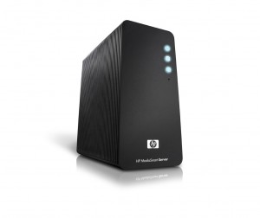


Estimating Costs
Two key costs that the optimizer considers:
I/O time – cost of reading pages from mass storage
CPU time – cost of applying predicates and operating on tuples in memory
Actual values are highly dependent on CPU and I/O subsystem on which the query will be run
Further complicating the job of the query optimizer
For a parallel database system such as PDW, the cost of redistributing/shuffling rows must also be considered
Were you paying attention or updating your Facebook page when I talked about parallel query processing 2 years ago?
IO + CPU
vs.

Slide 34
An Example
Reviews
Date | CID | MID | Rating
Query:
SELECT Avg(Rating)
FROM Reviews
WHERE MID = 932
Two physical query plans:
Optimizer estimates that predicate MID = 932 will be satisfied by 100 rows
Avg_agg [Cnt, Sum]
Avg_agg [Cnt, Sum]
Index Lookup MID = 932
Cost Y
Filter MID = 932
Which plan is cheaper ???
Cost X
Sequential
Scan
MID Index
Reviews
Reviews
Plan #1
Plan #2

Slide 35
Plan #1
Optimizer estimates total execution time of 9 seconds
Cost of
Plan #1
Avg_agg [Cnt, Sum]
Average computation is applied to 100 rows
At 0.1 microseconds/row, average consumes .00001 seconds of CPU time
Filter MID = 932
Filter is applied to 10M rows
At 0.1 microseconds/row, filter consumes 1 second of CPU time
Scan
Table is 100K pages with 100 rows/page
Sorted on date
Reviews is scanned sequentially at
100 MB/second
I/O time of scan is 8 seconds
Reviews

Slide 36
Plan #2
Optimizer estimates total execution time of 0.3 seconds
Cost of
Plan #2
At 0.1 microseconds/row, average consumes .00001 seconds of CPU time
Avg_agg [Cnt, Sum]
Average computation is applied to 100 rows
Index Lookup MID = 932
100 rows are estimated to satisfy the predicate
100 rows are retrieved using the
MID index
Since table is sorted on date field
(and not MID field), each I/O
requires a random disk I/O – about .003 seconds per disk I/O
I/O time will be .3 seconds
MID Index
Reviews
The estimate for Plan #1 was 9 seconds, so Plan #2 is clearly the better choice

Slide 37
But …
What if the estimate of the number of rows that satisfy the predicate MID = 932 is WRONG?
E.g. 10,000 rows instead of 100 rows
Plan 1 is better here
Plan 2 is better here

Slide 38



Estimating Join Costs
Three basic join methods:
Nested-loops join
Sort-merge join
Hash-join
Very different performance characteristics
Critical for optimizer to carefully pick which method to use when
M.Title, M.Director
Project
Join
R.MID = M.MID
C.CID = R.CID
Join
Movies
C.City = “NY”
Select
Select
R.Rating > 7
Customers
Reviews

Slide 39
Sort-Merge Join Algorithm
Sort Reviews on MID column
(unless already sorted)
Sort Movies on MID column
(unless already sorted)
“Merge” two sorted tables:
Scan each table sequential in tandem {
For current row r of Reviews For current row m of Movies
if r.MID = m.MID produce output row
Advance r and m cursors
}
Cost = 4 * |R| I/Os
Reviews.MID = Movies.MID
Merge
Join
Cost = 4 * |M| I/Os
Sort
Sort
Cost = |R| + |M| I/Os
Reviews
(|R| pages)
Movies
(|M| pages)
Total I/O cost = 5*|R| + 5*|M| I/Os
Main Idea: Sort R and M on the join column (MID), then scan them to do a ``merge’’ (on join column), and output result tuples.

Slide 40
Nested-Loops Join
For each page R_{i}, 1≤ i ≤ |R|, of Reviews
{ Read page R_{i} from disk
For each M_{j}, 1≤ j ≤ |M|, of Movies
{
Read page M_{j} from disk
For all rows r on page R_{i}
{
For all rows m on page M_{j}
{
if r.MID = m.MID produce output row
}
}
}
}
Nested Loops
Join
Reviews.MID = Movies.MID
Reviews (|R| pages)
Movies (|M| pages)
I/O Cost = |R| + |R| * |M|
Main Idea: Scan R, and for each tuple in R probe tuples in M (by scanning it). Output result tuples.

Slide 41
Index-Nested Loops
For each page R_{i}, 1≤ i ≤ |R|, of Reviews
{ Read page R_{i} from disk
For all rows r on page R_{i}
{
Use MID index on Movies to fetch rows with MID attributes = r.MID Form output row for each returned row
}
}
Nested Loops
Join
Reviews.MID = Movies.MID
Index Lookup using r.MID
Reviews
Cost = |R| + |R| * (||R||/|R|) * 2
2 I/Os: 1 index I/O + 1 movie I/O as Reviews table is sorted on date column
||R|| is # of rows in R
||R||/|R| gives the average number of rows of R per page
(|R| pages)
Sorted on date column
Notice that since Reviews is ordered on the Date column (and not MID), so each row of the Movies table retrieved incurs two random disk I/Os:
one to the index and
one to the table
MID Index
Movies (|M| pages)
Main Idea: Scan R, and for each tuple in R probe tuples in M (by probing its index). Output result tuples.
Notes:
[Cost of Outer Access] + ([Cardinality of Outer] * [Cost of Inner Access])

Slide 42
Estimating Result Cardinalities
Consider the query
SELECT *
FROM Reviews
WHERE 7/1 < date < 7/31 AND rating > 9
Assume Reviews has 1M rows
Assume following selectivity factors:
 | Sel. Factor | # of qualifying rows
7/1 < date < 7/31 | 0.1 | 100,000
Rating > 9 | 0.01 | 10,000
How many output rows will the query produce?
If predicates are not correlated
.1 * .01 * 1M = 1,000 rows
If predicates are correlated could be as high as
.1 * 1M = 100,000 rows
Why does this matter?

Slide 43

This is Why!
Project
Assume that:
Reviews table is 10,000 pages with 80 rows/page
Movies table is 2,000 pages
The primary index on Movies is on the MID column
Join
R.MID = M.MID
Rating > 9 and 7/1 < date < 7/31
Select
Movies
Reviews
Notice this is a log log plot
INL
NL
SM
Note that each join algorithm has a region where it provides the best performance
The consequences of incorrectly estimating the selectivity of the predicate on Reviews can be HUGE

Slide 44
Query Optimization: The Main Steps
Enumerate logically equivalent plans by applying equivalence rules
Enumerate
✓
1
For each logically equivalent plan, enumerate all alternative physical query plans
✓
enumerate
2
How big is the plan space for a query involving N tables?
Estimate the cost of each of the alternative physical query plans.
Estimate the selectivity factor and output cardinality of each predicate
Estimate the cost of each operator
✓
3
It turns out that the answer depends on the “shape” of the query
Run the plan with lowest estimated overall cost
4

Slide 45
Two Common Query “Shapes”
“Star” Join Queries
B
Number of logically equivalent alternatives
Join
# of Tables | Star | Chain
2 | 2 | 2
4 | 48 | 40
5 | 384 | 224
6 | 3,840 | 1,344
8 | 645,120 | 54,912
10 | 18,579,450 | 2,489,344
A
Join
F
Join
C
Join
D
“Chain” Join Queries
A
Join
B
Join
C
Join
D
Join
F
In practice, “typical” queries fall somewhere between these two extremes

Slide 46
Pruning the Plan Space
Consider only left-deep query plans to reduce the search space
Solution:
Use some form of dynamic programming
(either bottom up or top down)
to search the plan space heuristically
Bushy
Left Deep
Join
Join
These are counts of logical plans only!
With:
3 join methods
n joins in a query
There will be 3^{n} physical plans for each logical plan
Join
E
Join
Join
Join
D
A
B
C
Join
Join
C
D
E
A
B
 | Star Join Queries |  | Chain Join Queries
# of Tables | Bushy | Left-Deep | Bushy | Left Deep
2 | 2 | 2 | 2 | 2
4 | 48 | 12 | 40 | 8
5 | 384 | 48 | 224 | 16
6 | 3,840 | 240 | 1,344 | 32
8 | 645,120 | 10,080 | 54,912 | 128
10 | 18,579,450 | 725,760 | 2,489,344 | 512
Example:
For a left-deep, 8 table star join query there will be:
10,080 different logical plans
22,044,960 different physical plans!!
Sometimes these heuristics will cause the best plan to be missed!!

Slide 47
Bottom-Up QO Using Dynamic Programming
Optimization is performed in N passes (if N relations are joined):
Pass 1: Find the best (lowest cost) 1-relation plan for each relation.
Pass 2: Find the best way to join the result of each 1-relation plan (as the outer/left table) to another relation (as the inner/right table) to generate all 2-relation plans.
Pass N: Find best way to join result of a (N-1)-relation plan (as outer) to the N’th relation to generate all N-relation plans.
At each pass, for each subset of relations, prune all plans except those
Lowest cost plan overall, plus
Lowest cost plan for each interesting order of the rows
Order by, group by, aggregates etc. handled as the final step
Interesting orders include orders that facilitate the execution of joins, aggregates, and order by clauses subsequently by the query
In spite of pruning plan space, this approach is still exponential in the # of tables.
Notes:
16

Slide 48
An Example:
Select
Join
B
Join
Select
Legend:
SS – sequential scan
IS – index scan
– cost
A
Join
C
Select
5
D
First, generate all single relation plans:
A
B
C
D
All tables
IS
IS
IS
All single relation plans
13
SS
27
SS
73
38
SS
18
42
SS
95
A
A
B
C
C
D
D
Prune

Slide 49
Then, All Two Relation Plans
13
SS
IS
27
SS
73
IS
18
42
SS
All single relation plans
after pruning
A
A
B
C
D
NLJ
1013
SMJ
315
NLJ
822
SMJ
293
NLJ
2321
SMJ
932
SS
SS
SS
SS
IS
SS
IS
SS
SS
IS
SS
IS
A
B
A
B
A
B
A
B
B
C
B
C
NLJ
1013
SMJ
315
NLJ
756
SMJ
293
NLJ
1520
SMJ
432
SS
SS
SS
SS
SS
IS
SS
IS
SS
SS
SS
SS
B
A
B
A
B
A
B
A
B
D
B
D
NLJ
6520
SMJ
932
NLJ
1520
SMJ
432
IS
SS
IS
SS
SS
SS
SS
SS
Prune
C
B
C
B
D
B
D
B

Slide 50
Next, All Three Relation Plans
SMJ
SMJ
SMJ
Two relation plans after pruning
IS
SS
SS
SS
IS
SS
A
B
B
D
C
B
NLJ
NLJ
NLJ
SMJ
NLJ
NLJ
SMJ
IS
SMJ
SS
SMJ
IS
SMJ
IS
SMJ
IS
SMJ
SS
IS
SS
C
IS
SS
D
IS
SS
A
IS
SS
D
SS
SS
C
SS
SS
C
A
B
A
B
C
B
C
B
B
D
B
D
SMJ
SMJ
SMJ
SMJ
SMJ
SMJ
NLJ
SMJ
IS
SMJ
SS
SMJ
IS
SS
IS
SS
IS
SS
SMJ
SS
SMJ
SS
IS
SS
IS
SS
D
C
D
A
B
A
B
SS
SS
A
SS
SS
A
B
C
B
A
C
B
D
B
D
NLJ
SMJ
SMJ
IS
SMJ
IS
A
A
Prune
SS
SS
SS
SS
B
D
B
D

Slide 51
Three Relation Plans After Pruning
Select
Join
B
Join
Select
A
Join
C
Select
D
SMJ
SMJ
NLJ
SMJ
SS
SMJ
IS
SMJ
SS
Each will be expanded to include the missing table using both NLJ and SMJ methods, yielding a total of 12 plans
After a cost is estimated for each of the 12, the lowest cost plan will be chosen for execution
SS
SS
A
IS
SS
IS
SS
D
C
B
D
A
B
A
B
SMJ
SMJ
SMJ
IS
SMJ
IS
SMJ
SS
SMJ
IS
SS
IS
SS
D
SS
SS
C
A
C
B
C
B
B
D

Slide 52

You Have Now Seen the Theory
But the reality is:
Optimizer still pick bad plans too frequently for a variety of reasons:
Statistics can be missing, out-of-date, incorrect
Cardinality estimates assume uniformly distributed values but data values are skewed
Attribute values are correlated with one another:
Make = “Honda” and Model = “Accord”
Cost estimates are based on formulas that do not take into account the characteristics of the machine on which the query will actually be run
Regressions happen after hardware and software upgrades
What can be done to improve the situation?

Slide 53
Opportunities for Improvement
Develop tools that give us a better understanding of what goes wrong
Improve plan stability
Use of feedback from the QE to QO to improve statistics and cost estimates
Dynamic re-optimization

Slide 54
Towards a Better Understanding of QO Behavior
Picasso Project – Jayant Haritsa, IIT Bangalore
Bing “Picasso Haritsa” to find the project’s web site
Tool is available for SQL Server, Oracle, PostgreSQL, DB2, Sybase
Simple but powerful idea:
For a given query such as
SELECT * from A, B
WHERE A.a = B.b and
A.c <= constant-1 and
B.d <= constant-2
Systematically vary constant-1 and constant-2
Obtain query plan and estimated cost from the query optimizer for each combination of input parameters
Plot the results

Slide 55
Example: TPC-H Query 8
select
o_year,
sum(case
when nation = 'BRAZIL' then volume
else 0
end) / sum(volume)
from
(
select YEAR(O_ORDERDATE) as o_year,
L_EXTENDEDPRICE * (1 - L_DISCOUNT) as volume, n2.N_NAME as nation
from PART, SUPPLIER, LINEITEM, ORDERS, CUSTOMER, NATION n1, NATION n2, REGION
where
P_PARTKEY = L_PARTKEY and S_SUPPKEY = L_SUPPKEY
and L_ORDERKEY = O_ORDERKEY and O_CUSTKEY = C_CUSTKEY
and C_NATIONKEY = n1.N_NATIONKEY and n1.N_REGIONKEY = R_REGIONKEY and R_NAME = 'AMERICA‘ and S_NATIONKEY = n2.N_NATIONKEY and O_ORDERDATE between '1995-01-01' and '1996-12-31'
and P_TYPE = 'ECONOMY ANODIZED STEEL'
and S_ACCTBAL <= constant-1
and L_EXTENDEDPRICE <= constant-2
) as all_nations
group by o_year
order by o_year

Slide 56
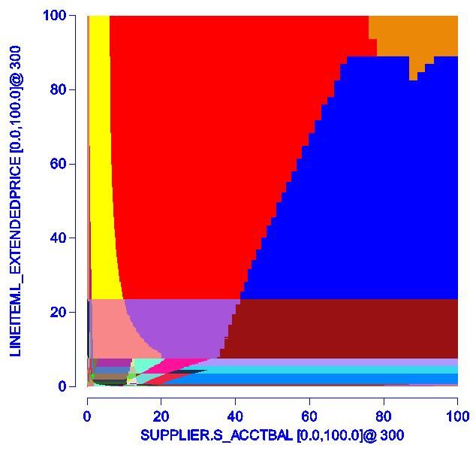
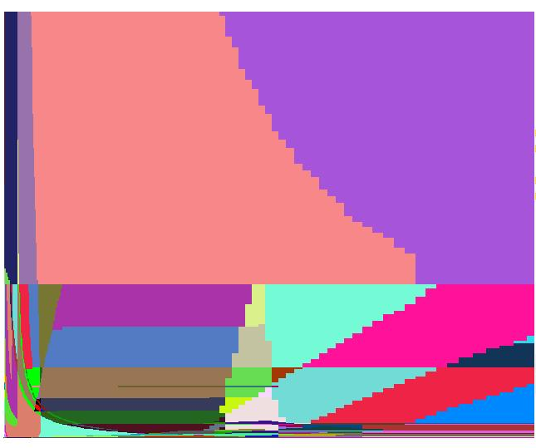
Resulting Plan Space
SQL Server 2008 R2
A total of 90,000 queries
300 different values for both L_ExtendedPrice and S_AcctBal
204 different plans!!
Each distinct plan is assigned a unique color
Zooming in to the [0,20:0,20] region:
Key takeaway: If plan choice is so sensitive to the constants used, it will undoubtedly be sensitive to errors in statistics and cardinality estimates ☹
Intuitively, this seems very bad!

Slide 57
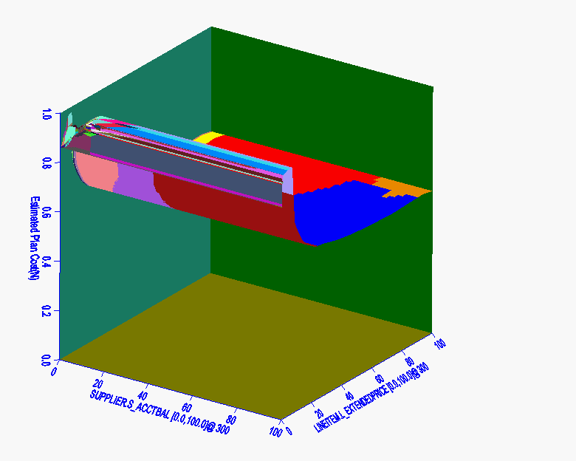
Estimated Execution Costs
Plan exhibits what is probably a “flaw” in the cost model:
As L_Extended price is increased, estimated cost first increases sharply before decreasing
Still a mystery why
QO is indeed harder than rocket science!!

Slide 58
How Might We Do Better?
Recall this graph of join algorithm performance
While the two “nested loops” algorithms are faster at low selectivity factors, they are not as “stable” across the entire range of selectivity factors
INL
NL
SM
Project
Rating > 9 and 7/1 < date < 7/31
Join
R.MID = M.MID
Select
Movies
QO should be plans that are more stable!
Reviews

Slide 59
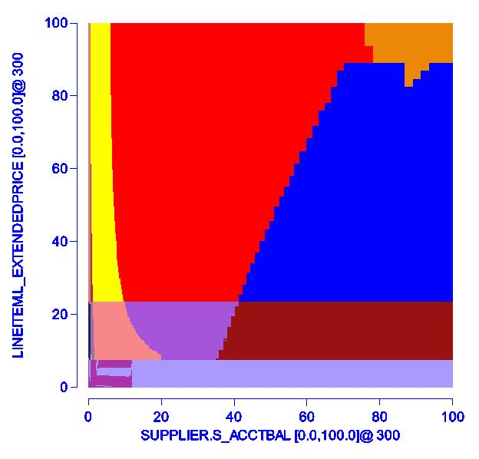
“Reduced” Plan Diagrams
Robustness is somehow tied to the number of plans
Fewer plans => more robust plans
For TPC-H query 8, it is possible to use only 30 plans (instead of 204) by picking more robust plans that are slightly slower (10% max, 2% avg)
Since each plan covers a larger region it will be less sensitive to errors in estimating cardinalities and costs
Reduced plan space for TPC-H query 8

Slide 60
How Might We Do Better?
At QO time, have the QO annotate compiled query plans with statistics (e.g. expected cardinalities) and check operators
At runtime, check operators collect the actual statistics and compare actual vs. predicted
Opens up a number of avenues for improving QO performance
Build an optimizer that learns
Do dynamic reoptimization of “in flight” queries
INL
INL
Check
IS
SMJ
IS
SMJ
A
IS
SS
A
Check
Check
C
B
IS
SS
C
B
60

Slide 61
Helping the Optimizer Learn
INL
Database
Query
Optimizer
Check
IS
Executor
Query Plan
SMJ
A
Check
Check
Catalogs
Statistics
IS
SS
Original
Observed Stats
& Observed
C
B
Statistics Tracker
Optimization of subsequent queries
benefits from the observed statistics

Slide 62
Dynamic Reoptimization
1) Observed output size of SMJ is 5x larger than expected
INL
Query
Optimizer
Check
IS
Executor
Database
Query Plan
SMJ
A
Tmp1
Check
Check
IS
SS
2) Output of SMJ is materialized as Tmp1 in tempdb
C
B
INL
Tmp1
IS
Actual
Stats
A
3) Remainder of query is returned to the optimizer for reoptimization

Slide 63



Key Points To Remember For The Quiz
Query optimization is harder than rocket science
The other components of a DBMS are trivial in comparison
Three key phases of QO
Enumeration of logical plan space
Enumeration of alternative physical plans
Selectivity estimation and costing
The QO team of every DB vendor lives in fear of regressions
How exactly do you expect them to make forward progress?

Slide 64
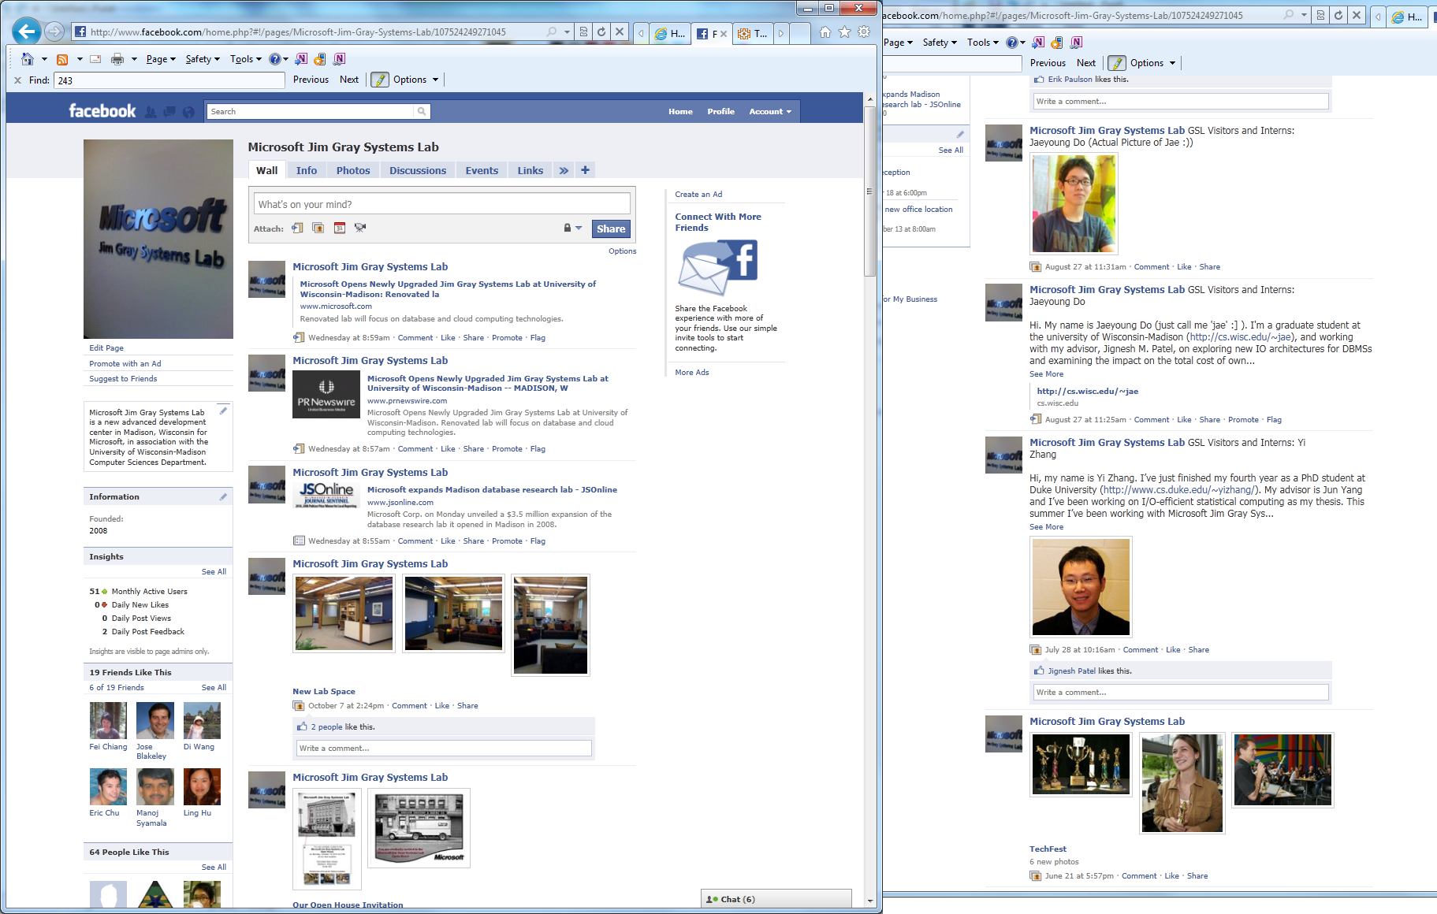
And…If You’ve Spent My Entire Keynote Chatting on Facebook…
At least, check out my lab
“Microsoft Jim Gray Systems Lab”:
The full slide deck for this talk can be found here

Slide 65
Many Thanks To:
Rimma Nehme, Pooja Darera, Il-Sung Lee, Jeff Naughton, Jignesh Patel, Jennifer Widom and Donghui Zhang for their many useful suggestions and their help in debugging these slides

Slide 66

Finally…
Thanks for inviting me to give a talk again
2011

